Slide 1
Fact-Checking, Fake News, and Propaganda:​ Solving the Disinformation Problem with Transformer-based Models
Anton Chernyavskiy, Dmitry Ilvovsky and Preslav Nakov
HSE University,
Moscow, Russia; HBKU, Qatar

Slide 2
Disinformation problem
The Internet is abundant in platforms that allow users to share information online
Unfortunately, not all such information is true
As manual fact-checking is a complex and time-consuming task, it is important to develop tools that can help automate the process of fact-checking at all its stages

Slide 3
Task formulations
Many task formulations have been proposed to address the spread of misinformation and disinformation online, and for each formulation, a number of approaches have been tried:
Rumor detection in social media
Fact-checking perspective on “fake news”
Process of proliferation of true and false news online
Stance detection
Propaganda detection
Predicting the factuality and the bias of entire news outlets
Multimodal disinformation detection
…

Slide 4
Overview
Here we focus on the following tasks:
FEVER task on Fact Extraction and VERification
Fake News Challenge
Detection of previously fact-checked claims (CLEF 2020 CheckThat! Task 2)
Detection of Propaganda Techniques in News Articles (SemEval 2020 Task 11)

Slide 5
FEVER task on Fact Extraction and VERification

Slide 6
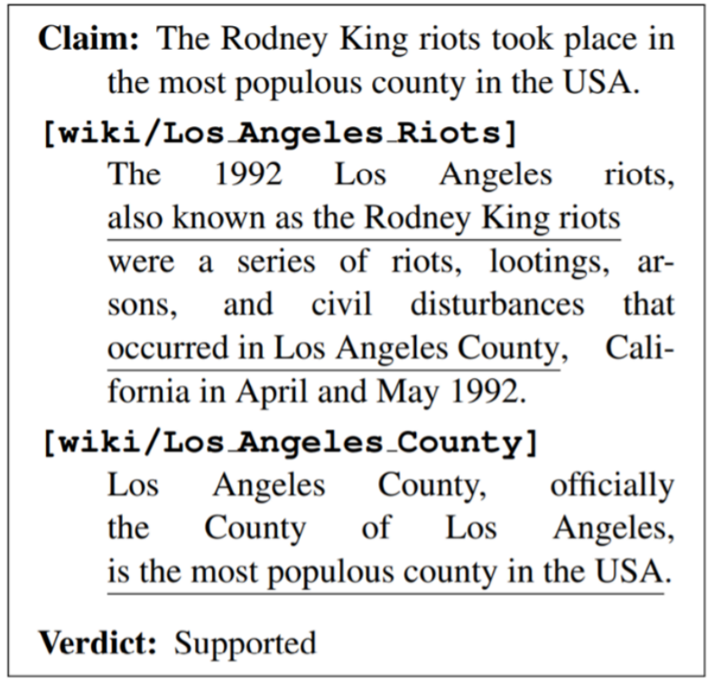
Task overview
FEVER dataset and task formulation enable Wikipedia-based explainable fact-checking. It includes a dump of 5.4M Wikipedia pages, and 220K statements labeled with one of the following three classes: Supports, Refutes or Not Enough Info.
Organizers investigated two general sub-tasks:
Extract qualitative information from the authoritative sources
Find the relationship between the extracted information and the verifiable claim

Slide 7
Related work
The dataset was used in two shared tasks, FEVER [1] and FEVER 2.0 [2], where most participating systems had the following three components:
Document retrieval using search API (Wikipedia Search, Google, Search, Solr, Lucene) or logistic regression
Sentence retrieval using Word Mover’s Distance, TF-IDF, logistic regression or neural networks (ESIM, BERT, bi-LSTM)
Natural language inference (NLI), that is recognizing of logical entailment, using Random Forest or neural networks, such as ESIM, DAM, LSTM and BERT

Slide 8

Our approach
Anton Chernyavskiy and Dmitry Ilvovsky. 2019. “Extract and aggregate: A novel domain-independent approach to factual data verification”.
In Proceedings of the Second Workshop on Fact Extraction and VERification (FEVER), pages 69–78, Hong Kong, China.
Combination of the most successful ideas of solving the fact-checking problem and general approaches: BERT, Infersent, CatBoost
Domain-independent pipeline that surpasses the previous ones
Independence of the components
Detailed analysis of the effect of natural language preprocessing: stemming, stop-words filtering, normalization, keywords highlighting, coreference resolution

Slide 9
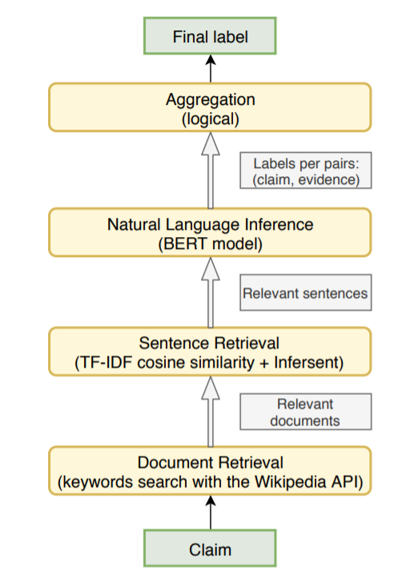
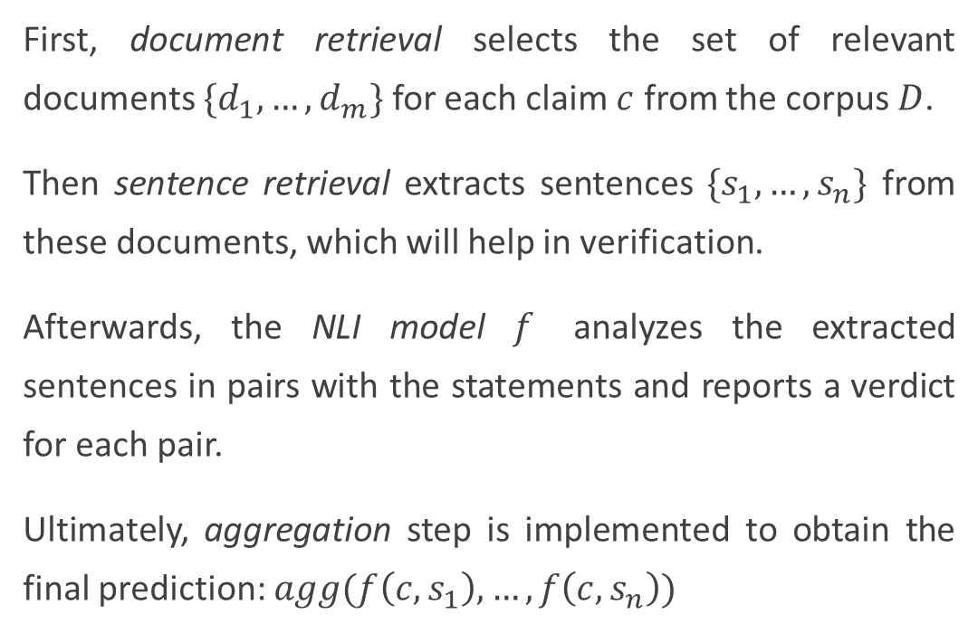
Model overview
First, document retrieval selects the set of relevant documents $\{d_{1},…,d_{m}\}$ for each claim $c$ from the corpus $D$.
Then sentence retrieval extracts sentences $\{s_{1},…,s_{n}\}$ from these documents, which will help in verification.
Afterwards, the NLI model $f$ analyzes the extracted sentences in pairs with the statements and reports a verdict for each pair.
Ultimately, aggregation step is implemented to obtain the final prediction: $agg(f\left(c, s_{1}\right),…,f\left(c,s_{n}\right))$

Slide 10
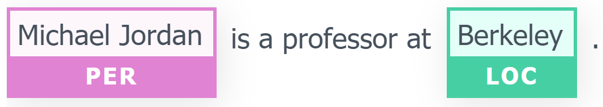
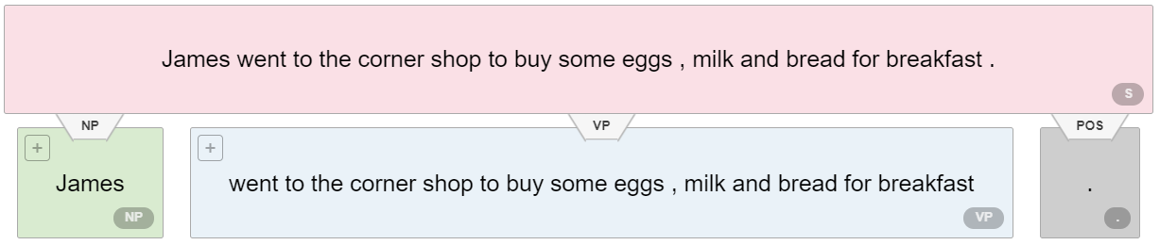
Document Retrieval
Which search queries can we use?
Named entities
Noun phrases
Part of the sentence up to the “head” word

Slide 11
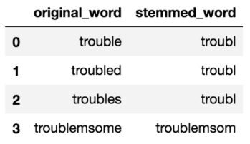
Document Retrieval
We applied Python Wikipedia API to retrieve relevant documents from Wikipedia corpus
To construct search queries, we used named entities (were extracted using a pre-trained bi-LSTM), noun phrases (were extracted using a pre-trained constituency parser), part of the sentence up to the “head” word (was extracted using a pre-trained dependency parser)
Only those documents that stemmed title fully contained an initial query were selected
Porter stemmer:

Slide 12
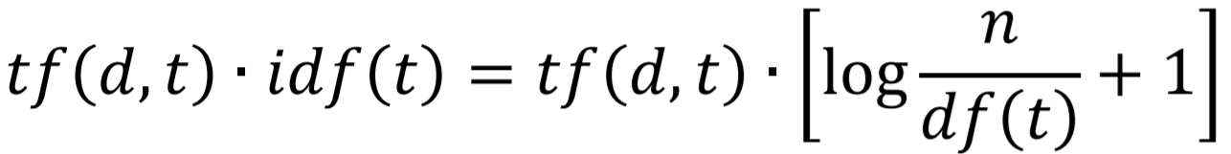
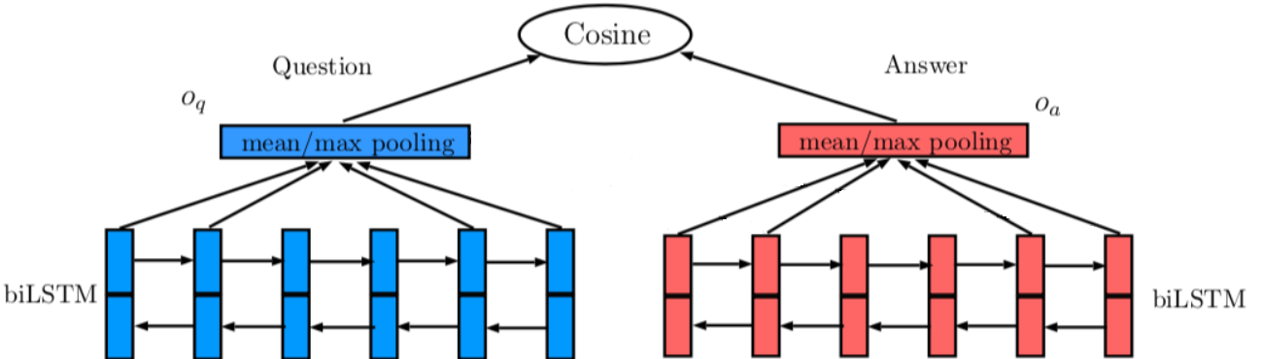
Sentence Retrieval
Lexical similarity: TF-IDF (term frequency – inversed document frequency)
Semantic similarity: InferSent
(Siamese bi-LSTM)

Slide 13
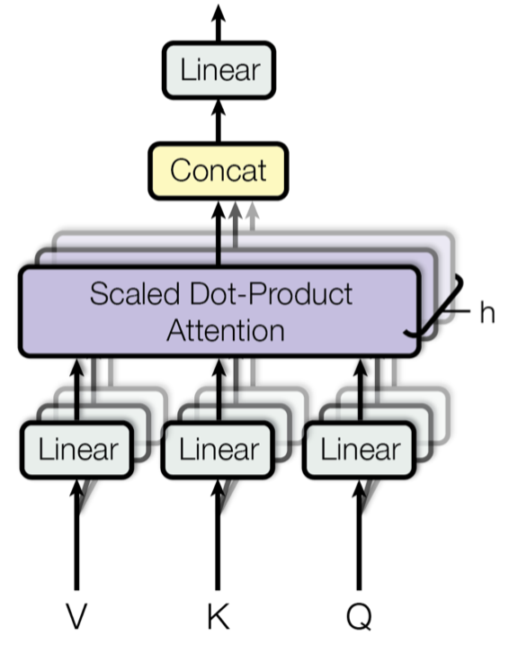
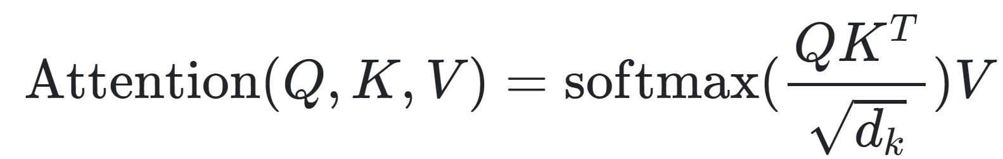
Natural Language Inference
Transformer-based models (BERT, RoBERTA, XLNet, …) achieved state-of-the-art results in various NLP tasks (GLUE), including Recognizing Textual Entailment (RTE) and Natural Language Inference (NLI)
Transformer – a sequence of encoder blocks consisting of a multi-head attention mechanism and fully connected layers
Intuitively, multiple attention heads allows for attending to parts of the sequence differently.
Formally for each word we have a query Q, a key K and a value V and calculate the attention as:

Slide 14
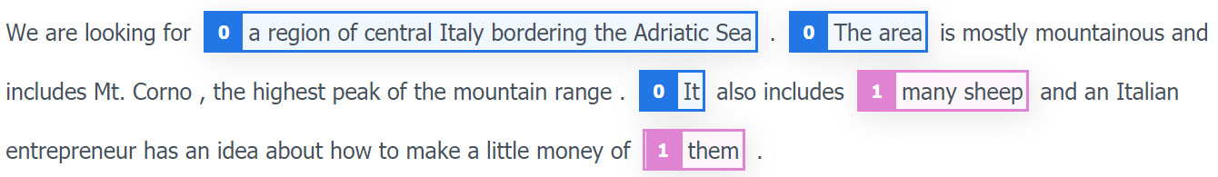
Natural Language Inference
BERT model was utilized
Sentences from the Sentence Retrieval paired with the claim statement were used as input
To solve the coreference problem, we added the titles of the documents to the beginning of the sentences through the separator
Coreference resolution example

Slide 15
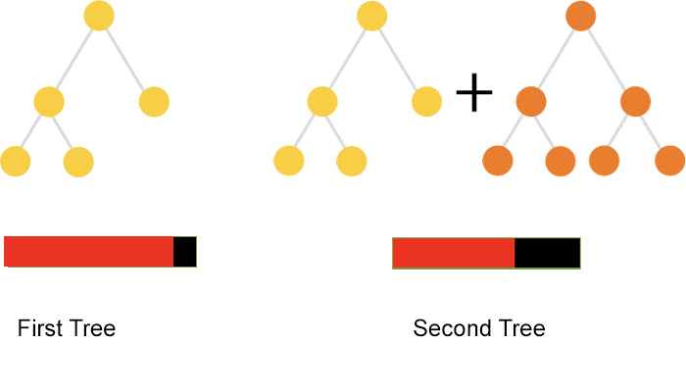
Aggregation
CatBoost gradient boosting model was applied as the main algorithm at this step
It was trained on the stacked predictions (classes probabilities) of the NLI model for the top-20 retrieved sentences

Slide 16
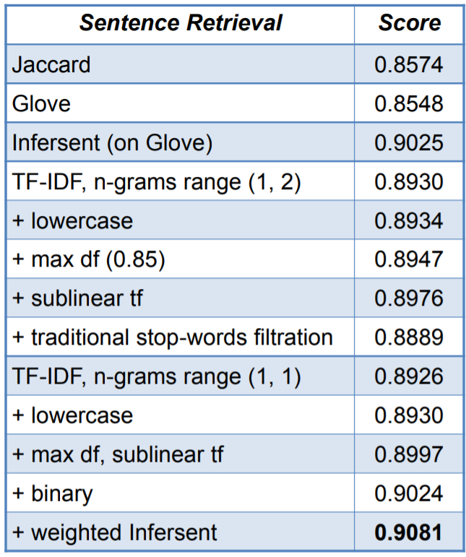
Results
Results of Sentence Retrieval on the validation set for the selection of the top-5 sentences:
tf/df – term/document frequency
sublinear tf = 1 + log(tf)
max df – all words with df higher than threshold are considered as stop-words.

Slide 17
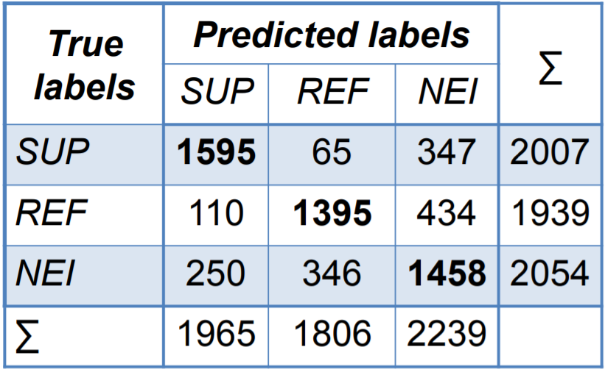
Results
Confusion matrix for CatBoost aggregation on the test part of the validation sample:
Additionally, BERT was trained for binary classification into classes “NOT ENOUGH INFO”/“ENOUGH INFO” and sentences were re-ranked by its scores.
However, it did not improve the results.
SUP = “SUPPORTS”
REF = “REFUTES”
NEI = “NOT ENOUGH INFO”

Slide 18
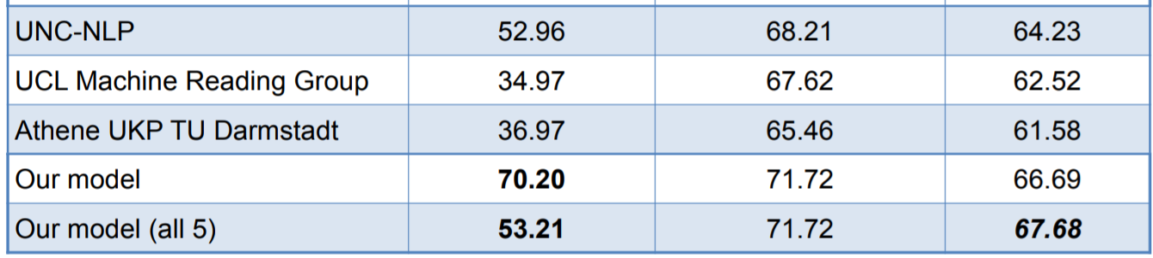
Results
Result evidence set construction options:
only those sentences which labels match with the final prediction
complement this set to 5 sentences, according to the ranking of the SR component

Slide 19
System demonstration
Several demos have addressed the task of fact-checking:
Hoaxy for tracking misinformation from social networks and news sites
CredEye for credibility assessment
Tracy which uses rules and knowledge graphs
STANCY for stance detection using BERT augmented with consistency constraints
FAKTA (Nadeem et al., 2019), which was trained on the FEVER dataset, but focused on stance and on evidence extraction from the Web

Slide 20
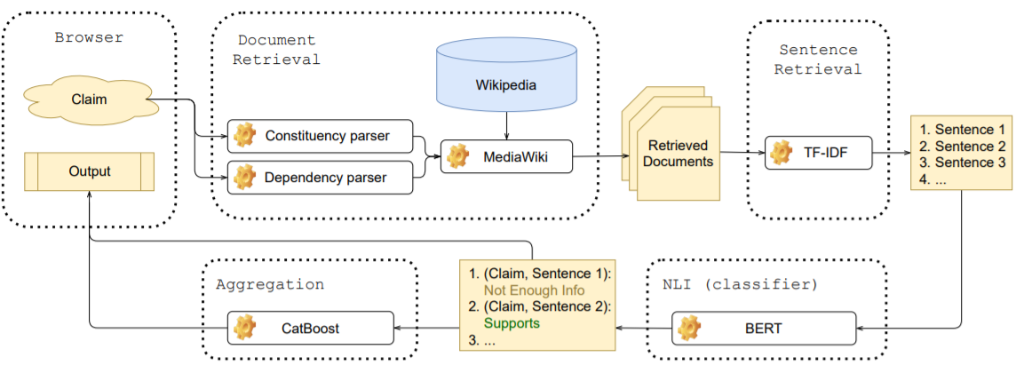
WhatTheWikiFact
Chernyavskiy, Anton, Dmitry Ilvovsky, and Preslav Nakov. "WhatTheWikiFact: Fact-Checking Claims Against Wikipedia." arXiv e-prints (2021): arXiv-2105.

Slide 21
System Architecture
The client part is implemented using the Streamlit framework—it is the GUI part, that is, the interface in the browser
The server part is implemented using the Fast API
Input: a list of up to 5 claims to verify, separated by line breaks
Output: a verdict, the system’s confidence in that verdict, and a list of possibly relevant documents: title and a link to the Wikipedia page + additional info, including a bar chart of the predicted stance labels
The system is available online: http://extmon.centralus.cloudapp.azure.com:8501/

Slide 22
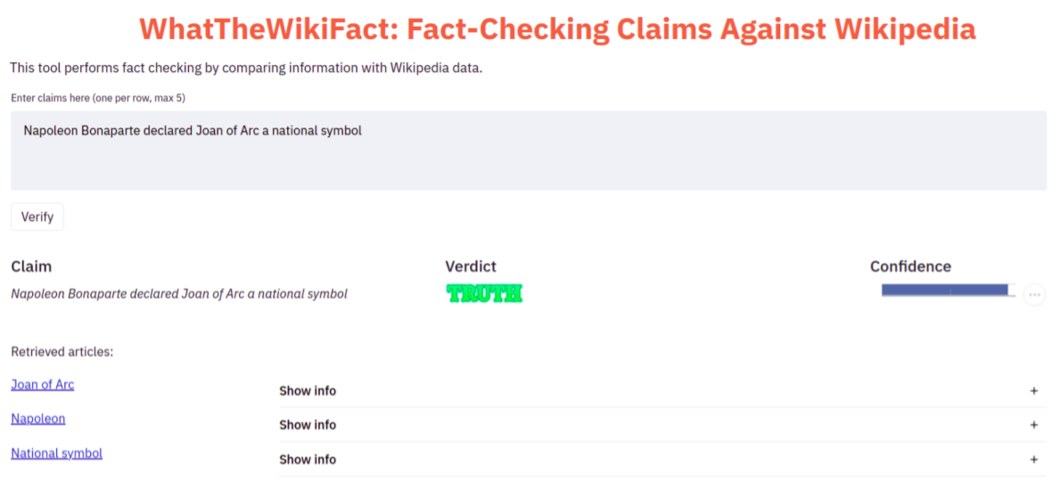
User interface example

Slide 23
Fake News Challenge

Slide 24
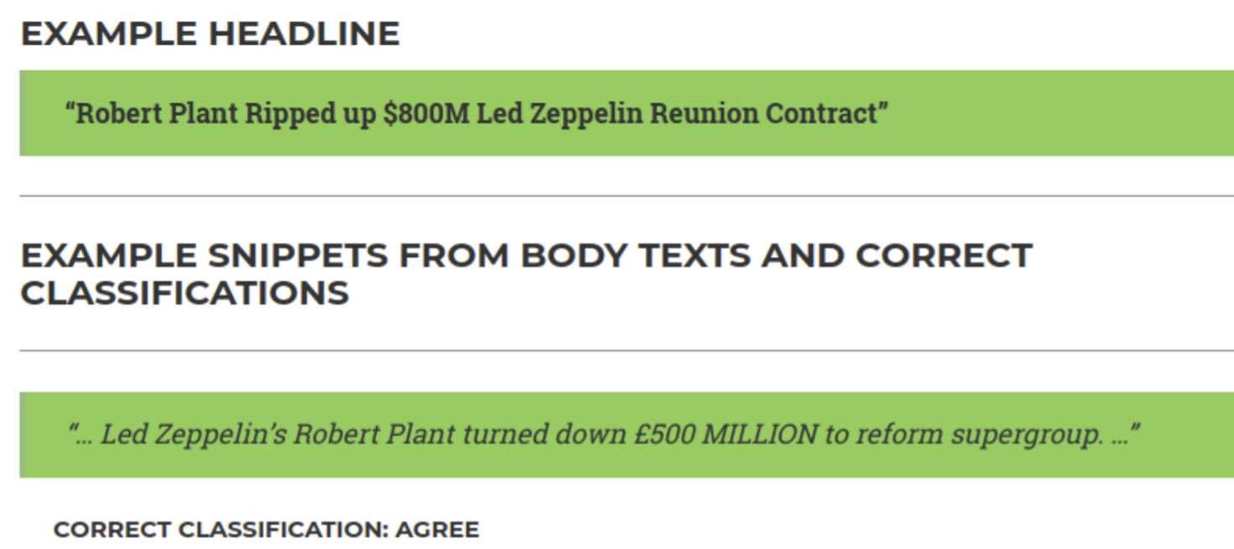
Task Overview
The Fake News Challenge competition [3] was held in 2017 with the aim of automating the Stance Detection task (it is a fact-checking element)
The data contains 4 classes of headers paired with the articles’ bodies:
Agrees
Disagrees
Discusses
Unrelated

Slide 25
Related work
In Fake News Challenge participants used conventional well-established machine learning models: Gradient boosting, Multilayer Perceptron (MLP)
These models were applied to the set of features, based on TF-IDF and word embeddings.
Another approach is to utilize standard machine learning methods for manually extracted features: n-grams; similarity of semantic embeddings, TF-IDF; BoW; length of sentences, etc.

Slide 26
Our approach
The FNC task is very similar to the FEVER task! We tested our approach to confirm that it is domain-independent
Document Retriever: Wikipedia Search API If the document contains none of the keywords, it is “unrelated”. Otherwise, we compare the maximum of cosine distances between TF-IDF embeddings of the claim and each sentence in the document with some threshold
Sentence Retriever: TF-IDF + InferSent
Natural Language Inference: To train BERT we used three classes “agrees”, “disagrees”, “discusses”. In contrast to FEVER, here the full paragraph composed of 5 separate sentences for each statement was used as the input because there is no ground-truth markup for the correct evidence
Aggregation

Slide 27
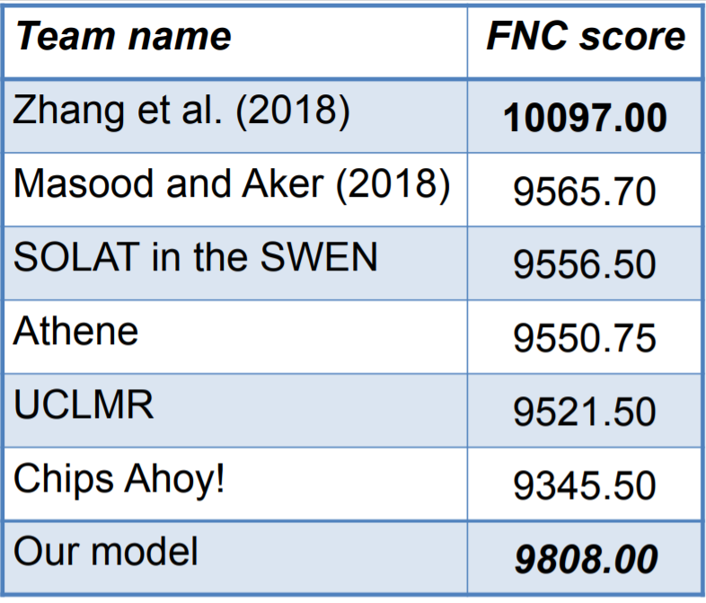
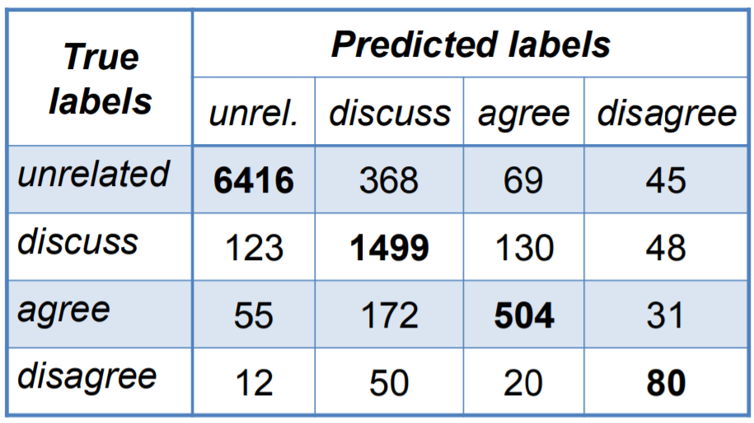
Results
Finding: Preliminary analysis of the presence of the keywords is important for document relevance determination. Our macro-averaged class-wise F1 score is 0.71. Models of competition participants achieve only 0.6.

Slide 28
Detection of previously
fact-checked claims
(CLEF 2020 – CheckThat! Task 2)

Slide 29
Task overview
We do not want to check the same fact many times
The dataset is aimed to facilitate the solution of a fact-checking problem: given an input claim, it asks to rank claims that have been previously fact-checked, so that claims that can help verify the input claim or parts thereof are ranked as high as possible
There are 800 Claim-Verified claim positive pairs for training and 200 for testing, and they are to be matched against a database of 10,369 verified claims [4]
There are no negative examples in the dataset

Slide 30
Related work
The authors of the dataset proposed to use an Elasticsearch algorithm based on BM25, trained separately (i) on the (Verified Claim) and (ii) on the (Verified Claim), combined with the title (Title) of the news article in which it appears
Additionally, they proposed to apply the pretrained Sentence-BERT model to encode claims and to rank by cosines between the resulting vector representations
Since the Sentence-BERT results were worse than the BM25, the authors took the top 50 statements retrieved by Elasticsearch and then re-ranked them using the RankSVM model
Reference: Sentence-BERT – Siamese BERT model, that obtains embeddings using the mean pooling operation

Slide 31
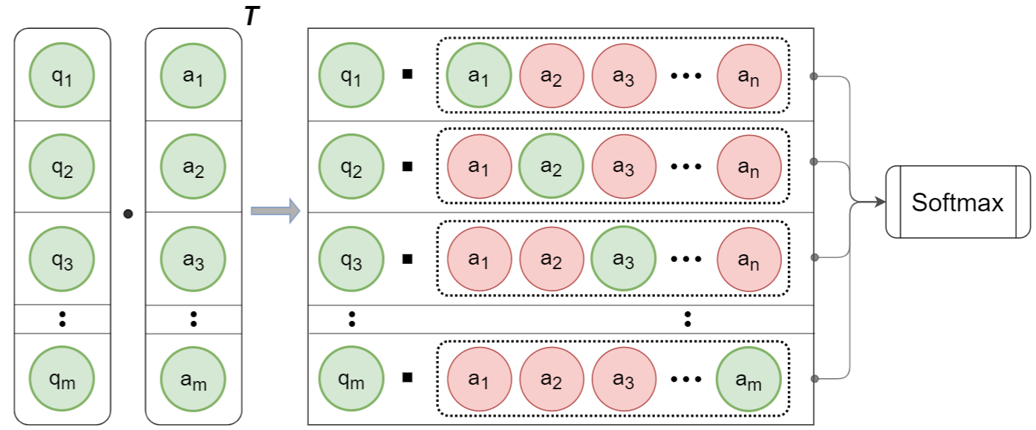
Loss functions
The authors of the dataset (Shaar et al.(2020)) used Sentence-BERT model without task-specific fine-tuning. How can we tune it?
MSE loss. It is a pointwise approach. Problem: it does not consider the relative order
Contrastive losses, such as triplet loss. Problem: it is hard to find non-trivial negatives examples
Solution: Batch-Softmax Contrastive loss, which use all possible pairs in the batch as negatives examples

Slide 32
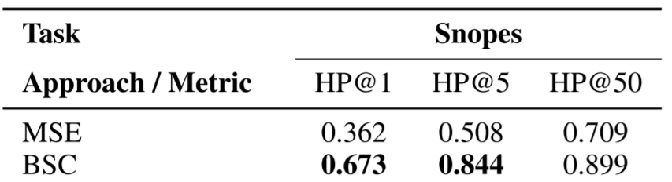
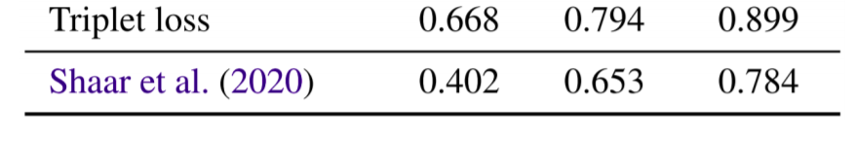
Our approach
BM25 is replaced to sublinear TF-IDF, since these approaches reached 0.859 and 0.861 on the MAP@5 validation set
We fine-tuned Sentence-BERT using the BSC loss, increasing MAP@5 from 0.527 to 0.872
At the re-ranking stage, instead of the RankSVM model, we applied the LambdaMART model (based on Gradient Boosted Decision Trees)
Results of fine-tuning Sentence-BERT model with different loss functions. BSC – Batch-Softmax Loss. HP@k – “Has Positive” among the top-k results

Slide 33
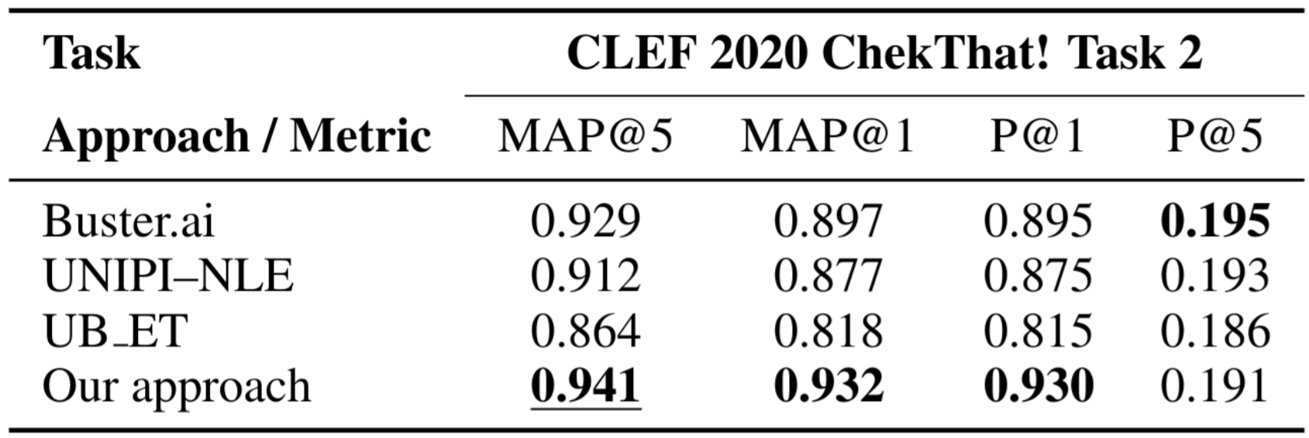
Results
The proposed approach outperforms not only baseline, but also current state-of-the-art methods. Results on the test sample of the competition dataset (top-3 teams):

Slide 34
Propaganda Detection

Slide 35
Task overview
Fake content evokes strong emotions
Propaganda uses psychological and rhetorical techniques to reach its purpose. Such techniques include the use of logical fallacies and appealing to the emotions of the audience.
Subtask A: span identification (SI): detecting the propaganda spans in an article. This is a binary sequence tagging task.
Subtask B: technique classification (TC): detecting the type of propaganda used in a given text span. This is a multi-label classification problem (on 18 classes).
Dataset: training, development and test datasets contain 371, 75, and 90 news articles with 6,128, 1,063 and 1,790 spans, respectively [5]

Slide 36
Related work
There was a related previous task on fine-grained propaganda detection, where the participants used Transformer-style models, LSTMs and ensembles
Some approaches further used non-contextualized word embeddings, e.g., based on FastText and GloVe, or handcrafted features such as LIWC, quotes and questions
For the fragment-classification subtask (a combination of two subtasks) the LSTM-CRF or biLSTM-CRF models were applied besides BERT
Moreover, some efforts have been made to increase the size of the dataset using unsupervised language model pre-training

Slide 37
Our approach
General idea: solve both subtasks with Transformer-based models (RoBERTa) fixing their task-specific limitations
Reference: RoBERTa builds on BERT and modifies key hyperparameters, removing the next-sentence pretraining objective and training with much larger mini-batches and learning rates
Chernyavskiy, Anton, Dmitry Ilvovsky, and Preslav Nakov. (2020). Aschern at SemEval-2020 Task 11: It Takes Three to Tango: RoBERTa, CRF, and Transfer Learning. SemEval@COLING
Chernyavskiy, Anton, Dmitry Ilvovsky, and Preslav Nakov. Transformers: “The End of History” for NLP?. arXiv e-prints (2021): arXiv-2105.

Slide 38
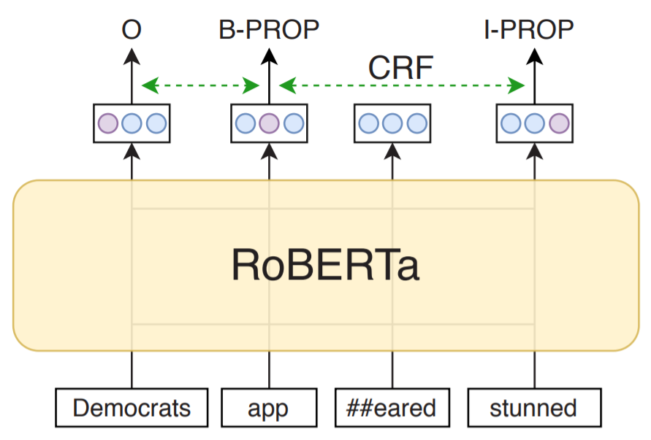
System (Subtask A)
Task setup: BIO-encoding sequence labeling
Model: RoBERTa + Additional CRF layer (as there is no modeling of the dependency between the predicted labels)
Post-processing: Punctuation correction—e.g., in a case like <"It is what it is."> quotes should be included in the span, whereas in the dot should not be included
Ensemble: Union of the predicted spans from two same models

Slide 39
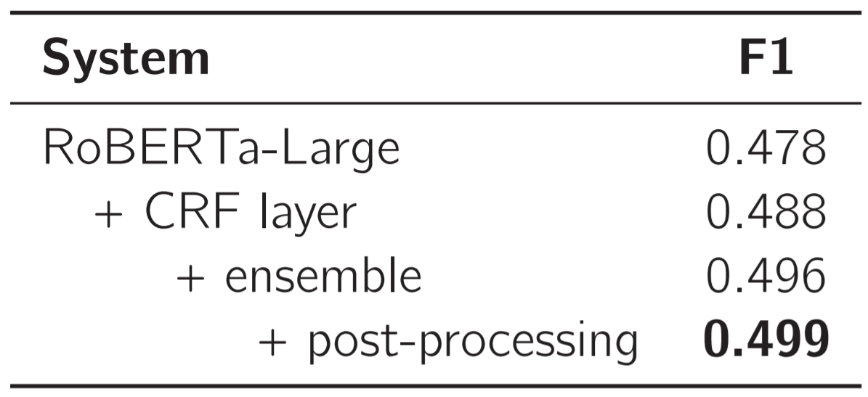
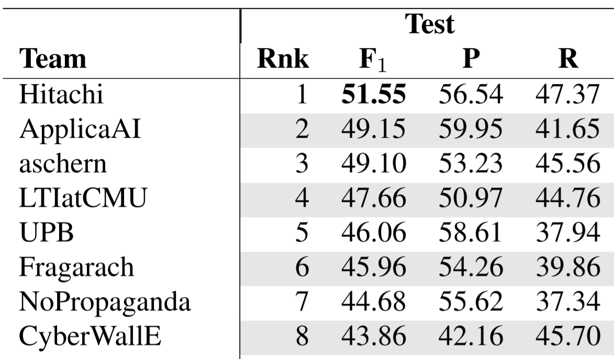

Results (Subtask A)
BIO tagging format performed better than IO and BIOUL
RoBERTa sometimes produced not well-formed outputs, that was fixed by CRF
Handling the dependency between labels did not eliminate punctuation errors
Validation results

Slide 40
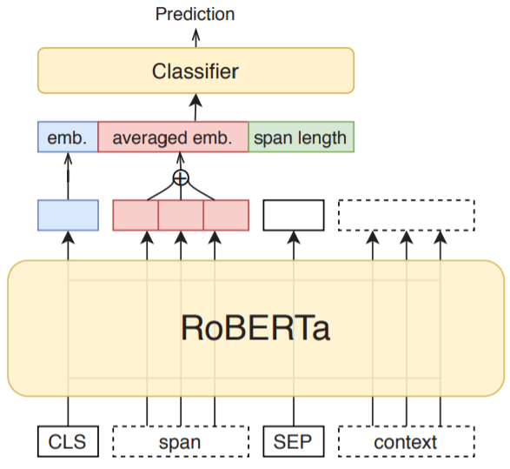
System (Subtask B)
Task setup: Multi-class single-label problem – at training time, multiple copies of each multi-label example are created
Model: RoBERTa-Large
Input is [CLS] <span> [SEP] <sentence>, where <sentence> is the sentence from which the span was extracted
Transfer learning from subtask A
Extended [CLS] embedding

Slide 41
System (Subtask B)
Post-processing:
Assign Repetition if cleaned span (stemmed and without stopwords) match at least two other spans within the article or have a high predicted probability
Increase predicted probabilities of <span>→<label> pairs from the train set (“gazetteer”)
Improve local consistency by correction of combinations of unseen nested spans—e.g., Causal Oversimplification is generally long and it can contain a subspan of Loaded Language
Handle multi-label setup by assigning top-n propaganda techniques
Ensemble: Logistic regression over posterior probabilities produced by source RoBERTa and modified with additional features (from the figure)

Slide 42
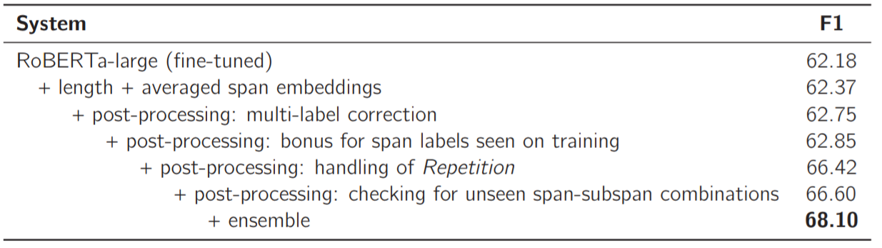
Results (Subtask B)
Handling the Repetition yielded the biggest improvement of F1
Using length as an extra feature of [CLS] embedding improved the results (albeit marginally)
Model made errors even in “easy” train examples
Even two models ensemble significantly stabilized the final quality

Slide 43
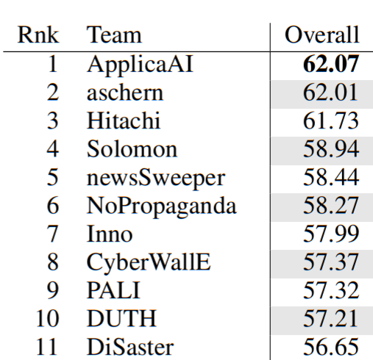
Results (Subtask B)
Future work: explore how to eliminate model limitations, fixed with post-processing
Results on the test set:
“Overall” – macro-averaged F1 score over all propagandistic classes

Slide 44
References
[1] James Thorne, Andreas Vlachos, Oana Cocarascu, Christos Christodoulopoulos, and Arpit Mittal. 2018. The fact extraction and VERification (FEVER) shared task. In Proceedings of the First Workshop on Fact Extraction and VERification (FEVER), pages 1–9, Brussels, Belgium.
[2] James Thorne, Andreas Vlachos, Oana Cocarascu, Christos Christodoulopoulos, and Arpit Mittal. 2019. The FEVER2.0 shared task. In Proceedings of the Second Workshop on Fact Extraction and VERification (FEVER), pages 1–6, Hong Kong, China.
[3] Andreas Hanselowski, Avinesh PVS, Benjamin Schiller, Felix Caspelherr, Debanjan Chaudhuri, Christian M. Meyer, and Iryna Gurevych. 2018. A retrospective analysis of the fake news challenge stance-detection task. In Proceedings of the 27th International Conference on Computational Linguistics, pages 1859–1874, Santa Fe, New Mexico, USA.
[4] A. Barron-Cedeno, Tamer Elsayed, Preslav Nakov, Giovanni Da San Martino, Maram Hasanain, Reem Suwaileh, Fatima Haouari, Nikolay Babulkov, Bayan Hamdan, Alex Nikolov, Shaden Shaar, and Zien Sheikh Ali. 2020. Overview of checkthat 2020: Automatic identification and verification of claims in social media. In CLEF
[5] Giovanni Da San Martino, Alberto Barron-Cedeno, Henning Wachsmuth, Rostislav Petrov, and Preslav Nakov. 2020. SemEval-2020 task 11: Detection of propaganda techniques in news articles. In Proceedings of the Fourteenth Workshop on Semantic Evaluation, pages 1377–1414, Barcelona (online).

